Slide 1
Zambia’s Approach to Safeguards and Safeguard Information System
Ministry of Development Planning
CLIMATE CHANGE SECRETARIAT
Presented By:
Deuteronomy Kasaro
Mitigation Specialist
National Climate Change Secretariat
Zambia

Slide 2
Structure of Presentation
Forest Resources
Approach to legal preparedness
Consensus on Safeguards
Scope of Study
Key Findings
Innovative laws and Institutions
Current Governments Actions
Conclusion

Slide 3
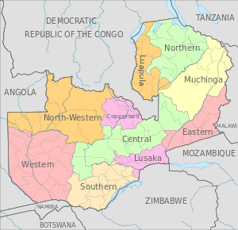
Zambia

Slide 4
Zambia
752,614Km² with a population of 13million
49.9 million ha (66% of land cover)
Maily Miombo woodlands: Semi-evergreen forests; Deciduous Forests; Evergreen forests; Shrub thickets, grasslands, wooded grasslands
61,000 ha
250,000 to 300,000ha per annum
Unsustainable agricultural practices; Charcoal and wood fuel use; Timber production; Infrastructure development (includes mining)
Surface Area:
Forest Cover:
Vegetation Type:
Plantations:
Deforestation rate
Drivers

Slide 5
Process of Reviewing Policies and Laws in Zambia
POLICY
Gap is identified
Stakeholder Consultations
Draft Policy
Consensus building on key elements and validated
Submitted to Cabinet for approval
Dissemination and Implementation
LEGISLATION
Gap is identified
Stakeholder Consultations
Seek Cabinet approval to review
Layman’s draft is prepared
Consensus building
Ministry of Justice provides professional version
Stakeholder validation
Submitted tabled in Parliament for approval
Dissemination and Implementation

Slide 6
Preparedness for REDD+ and Safeguards
Conducted a number of stakeholder consultative meetings and studies as a basis for planning.
  Legal Preparedness for REDD+
  Assessing the Role of Safeguards, Enforcement and Governance in REDD+
  Analytical study establishing possible synergies between FLES and the provision of information on safeguards in Zambia

Slide 7
1. Scope of the study on Legal Preparedness
Zambia’s broader governance framework
Climate change strategies
Land use, ownership and management
Forestry
Integrated environmental management
Energy and electricity
Trade, investment and financial accountability

Slide 8
Scope of Country Study
Over 50 policies, laws and regulations were reviewed and analyzed including:
Constitution of 1996
Draft Constitution of 2010
Forests Act of 1973
Forests Act of 1999
Environmental Management Act of 2011
Water Resources Management Act of 2011
Electricity Act of 1995
Energy Regulation Act of 1995
Lands Act of 1995
Draft Land Administration and Management Policy of 2006
Lands Acquisition Act of 1970
Lands and Deeds Registry Act of 1994
Lands Survey Act of 1960
Human Rights Commission Act of 1996
Agricultural Lands Act of 1960
Local Government Act of 1991
Mines and Minerals Development Act of 2008
Draft Urban and Regional Planning Bill of 2009
National Agricultural Policy (2004-2015)
National Anti-Corruption Policy of 2009
Public Audit Act of 1980
Public Procurement Act of 2011
Zambia Development Agency Act of 2006

Slide 9
Legal Preparedness Study recognised Innovative Laws and Institutions
Forestry Policy and Forests Act have been revised to improve forest management and land management
Statutory Instruments used for a phased approach to legal Framework e.g. Piloting of JFM
Reforms to fiscal transparency and accountability [introduction of the Integrated Financial Management Information Systems (IFMIS)]
Integrated land-use planning on customary and state land now part of the revised Town and Country Planning Act
Decentralization Policy enhances participation in decision making process
Environmental Council of Zambia transformed into the Environmental Management Authority with added responsibilities and authority

Slide 10
2. Assessing the Role of Safeguards, Enforcement and Governance in REDD+
Safeguards, Enforcement & Governance relevant for REDD+:
Rights & ownership of forest carbon
Conflict redress & management system
National safeguard policies & laws
Access to & sharing of information
Public participation in decision-making
Strong monitoring, reporting & verification (MRV) system

Slide 11
3. Forest livelihood and Economic Survey and safeguards
Cancun safeguards thematic elements |  | Will FLES provide useful information for the thematic safeguard element?
a) | Complement or consistent with the objectives of national forest programmes | No, exceeds the scope of FLES
 | Complement or consistent with relevant international conventions and agreements | No, exceeds the scope of FLES
b) | Information on the transparency of national forest governance structures | No, exceeds the scope of FLES
 | Information on the ‘effectiveness’ of national forest governance | Partially
c) | Information on who is considered indigenous peoples/tribal people and members of local communities | Partially
 | Information on how the rights of indigenous peoples/tribal people and members of local communities under international law are respected | Partially
d) | Information on the enabled environment for effective participation | Partially
 | Information on the FPIC for indigenous/tribal people | No, exceeds the scope of FLES
e) | Information on the Non conversion of natural forest | Partially
 | Protection and Conservation of Natural Forests and Biodiversity | Partially
f) & g) | Monitoring and assessment | Partially
 | Measures to tackle reversals and displacement | Partially
 | International cooperation | No, exceeds the scope of FLES

Slide 12
Consensus on Approach to Safeguards
In order to fully respect the country’s legal, institutional and compliance frameworks and in order to operationalize international safeguards at the national level, a national level safeguard system will be formulated for Zambia.
Must be rooted in Zambia’s existing legal framework (national policies, laws and regulations that define and regulate the effective implementation and compliance of the safeguards);
Must be based on the country’s institutional framework (existing procedures for implementing and enforcing the legal framework);
An outline of the compliance framework (with a monitoring and information system; grievance and redress mechanisms; and noncompliance mechanisms);
To serve as a cross-sectoral framework for environmental and social performance across all land-based sectors - forestry, agriculture, mining, infrastructure development and domestic energy.

Slide 13
Key milestones achieved
Government has revised a number of policies and Legislations
Wide stakeholder consultations conducted
Consensus among stakeholders
Harmonised approach to addressing safeguards
The revised Forests Act provide authority to local communities to manage forests

Slide 14
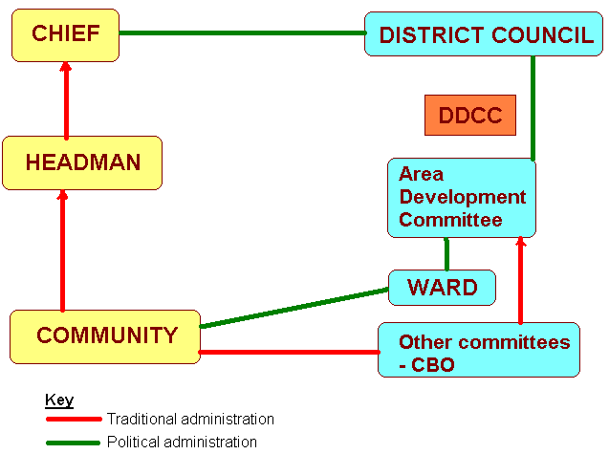
The REDD+ Strategy recognizes the Traditional and Political Structures

Slide 15
Some National Policies and Legislations supporting REDD+ safeguard System
The National Forestry Policy and the Forests Act No. 4 of 2015 (Revised in 2015)
  Broad based participation;
  Equity and responsibility;
  Sustainable Forest management;
  Holistic and ecosystem based ;
  Abatement of climate change;
  Precautionary principle;
  Free, prior informed consent.
Local communities can apply to manage forests and can partner with others (including private sector;
Carbon by law is a Forest Resource and a major forest produce. Therefore, local communities are protected

Slide 16
Other legal safeguards
The Environmental Management Act
  transformed the Environmental Council of Zambia into the Zambia
  Protects biological diversity resources
  Empowers the local communities to sue if not happy with process and action taken by government
Town and Country Planning Act (Revised in 2015)
  Now provides for land use planning in both urban and rural areas (state and customary land)
Lands Tribunal
  Deals with issues to conflicts over land and has powers of the High court

Slide 17
Challenges and Opportunities
Currently planning to harmonize the safeguard information system to cater for all Programmes and initiatives;
Government support in facilitating the implementation of REDD+ Strategy;
Programmes being designed are being harmonized (BioCarbon Funds, UN-REDD, FIP);
Challenge is that consultative processes are expensive and hence take long.

Slide 18
Results compared to expectations:
Different partners had different thoughts on the approach to REDD+ Safeguards;
Government opted to take a national approach using existing structures and processes;
Hence the approach has been within planned approach

Slide 19
Lessons learned
Existing laws and legislations provide the foundation for any positive progress to be achieved
Traditional systems (local community) are needed to ensure a sound and sustainable safeguard information system
There is need for a common understanding of what the safeguards and the safeguard information system are

Slide 20
Next steps
Harmonize the approach to safeguards for all partners and Programmes
Finalise the development of the Safeguards Information Systems
Complete the National Forest Monitoring System and finalise the link with the Safeguards information System

Slide 21
CONCLUSION
Since various laws in Zambia are linked to REDD+, it is important to recognize that a phased approach and mainstreaming is done to responding to the needs of REDD+ is taken into account.

